Slide 1


Slide 2
PHP
Hypertext Preprocessor
A programming language devised by Rasmus Lerdorf in 1994 for building dynamic, interactive Web sites.
Cross-platform:
Most PHP code can be processed without alteration on computers running many different operating systems.
For example, a PHP script that runs on Linux generally also runs well on Windows.
HTML-embedded:
PHP code can be written in files containing a mixture of PHP instructions and HTML code.

Slide 3

PHP
Server-side:
The PHP programs are run on a server—specifically a Web server.
Web-scripting language:
PHP programs run via a Web browser.
Case Sensitive

Slide 4
System Requirement
To run php code you will need at least the following software:
Server software (an operating system such as Windows 7 or Linux)
A PHP-compatible Web server (such as Apache or Internet Information Server (IIS)
PHP7 (get the download from www.php.net)
A relational database system (SQLite, MySQL, Maria DB)
A Web browser (such as Chrome, Firefox, and so on)
A text editor, such as Sublime, VS Code, Atom, and so on.

Slide 5

System Requirement
More easier, just install software bundle like XAMPP: https://www.apachefriends.org/download.html

Slide 6

Hello World!
<html> <head> <title>PHP Test</title> </head> <body> <?php echo '<p>Hello World!</p>'; ?> </body> </html>

Slide 7
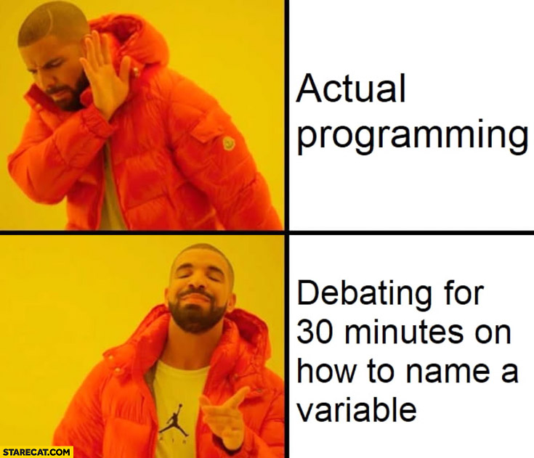
Variables
Issues concerning creating variables:
Naming
Data type
Scope

Slide 8
Naming Variables
Variable names begin with a dollar sign ($).
The first character after the dollar sign must be a letter or an underscore.
The remaining characters in the name may be letters, numbers, or underscores without a fixed limit. Example:
<?php $my_first_variable = 0; ?>

Slide 9
Data Types
Data type | Description
Boolean | Scalar; either True or False
Integer | Scalar; a whole number
Float | Scalar; a number which may have a decimal place
String | Scalar; a series of characters
Array | Compound; an ordered map (contains names mapped to values)
Object | Compound; a type that may contain properties and methods
Resource | Special; contains a reference to an external resource, such as a handler to an open file
NULL | Special; may only contain NULL as a value, meaning the variable; explicitly does not contain any value

Slide 10
Operators
Operator | Name | Description | Example | Result
x + y | Addition | Sum of x and y | 2 + 2 | 4
x - y | Subtraction | Difference of x and y | 5 - 2 | 3
x * y | Multiplication | Product of x and y | 5 * 2 | 10
x / y | Division | Quotient of x and y | 15 / 5 | 3
x % y | Modulus | Remainder of x divided by y | 5 % 2 10 % 8 10 % 2 | 1 2 0
- x | Negation | Opposite of x | - 2

Slide 11
Variable Scope
Local Scope : Any Variable used inside function
<? function send_data() {
$my_data = "Inside data";
echo $my_data; } ?>
Global Scope: Any variable outside function
<?php $a = 1;$b = 2; function Sum() { global $a, $b;
$b = $a + $b; } echo $b; ?>

Slide 12
Super Global arrays
Array | Description
$GLOBALS | Has a reference to every variable that has global scope in a PHP program. Many of the variables in it are also in other superglobal arrays
$_SERVER | Includes everything sent by server in the HTTP response, such as the name of the currently executing script, server name, version of HTTP, remote IP address, and so on. Although most Web server software produces the same server variables, not all do, and not all server variables necessarily have data in them
$_GET | Contains all the querystring variables that were attached to the URL, or produced as a result of using the GET method
$_POST | Contains all the submitted form variables and their data. You use variables from the $_POST or $_REQUEST arrays extensively in most of your PHP programs. For example, to make use of a username or password (or any other data) submitted as part of a form, you'll use PHP variables from the $_REQUEST array

Slide 13
Super Global arrays
Array | Description
$_COOKIE | Contains all cookies sent to the server by the browser. They are turned into variables you can read from this array, and you can write cookies to the user's browser using the setcookie() function. Cookies provide a means of identifying a user across page requests (or beyond, depending upon when the cookie expires) and are often used automatically in session handling
$_FILES | Contains any items uploaded to the server when the POST method is used. It's different from the $_POST array because it specifically contains items uploaded (such as an uploaded image file), not the contents of submitted form fields
$_ENV | Contains data about the environment the server and PHP are operating in, such as the computer name, operating system, and system drive
$_REQUEST | Contains the contents of the $_GET, $_POST, and $COOKIE arrays, all in one

Slide 14
Query String
Sometime, you could write a PHP program that generates a query string attached to a URL using code such as this (assuming you had the $first_name and $last_name variables already set):
Ex:
<a href="http://www.myplace.com?first_name=<?php echo $first_name; ?>">Click Here</a>
When this code runs, it produces the following output:
<a href="http://www.myplace.com?first_name=John">Click Here</a>

Slide 15
Attributs Forms Elements
Action Attribute
Tells to server which page to go to
<form action="myprogram.php">
...
</form>
Method Attribute
The method attribute controls the way that information is sent to the server.
<form action="myprogram.php" method="GET">
or
<form action="myprogram.php" method="POST">

Slide 16
Get Value
Browser automatically appends the information to the URL when it sends the page request to the web server
<form action=“test.php" method="GET">
If submit clicked then page will redirect to
http://www.nonexistentserver.com/test.php?furryanimal=cat&spikyanimal=porcupine
http://localhost/form.php?TextArea=lorem

Slide 17
URL Encoding
Character | URL Encoding
Tab | %09
Space | %20
! | %21
" | %22
# | %23
% | %25
& | %26
( | %28
) | %29
+ | %2B
, | %2C
. | %2E
/ | %2F
: | %3A
; | %3B
< | %3C
> | %3E
= | %3D
? | %3F
@ | %40
\ | %5C

Slide 18
Post Value
Information in the form is sent in the body of http request and doesn’t appear in the url
<form action="myprogram.php" method="POST">

Slide 19
HTML Form Fields
Text Fields
<input type="text" name=“text1”/>
Password Field
<input type="password" name =“pass”/>
Radio Buttons
<input type="radio" name=“radio1” value=“Men”/>
<input type="radio" name=“radio1” value=“Women”/>
Checkboxes
<input type="checkbox" name="vehicle" value="Bike" />
<input type="checkbox" name="vehicle" value="Car" />
Submit Button
<input type="submit" value="Submit" />
Hidden fields
<input type="hidden" name=“product_id" value="122">

Slide 20
PHP Form Handling
Get Value
<html> <body> Welcome <?php echo $_GET[“text1"]; ?>!<br /> Your password is <?php echo $_GET[“pass"]; ?>. </body> </html>
Post Value
<html> <body> Welcome <?php echo $_POST[“text1"]; ?>!<br /> Your password is <?php echo $_POST[“pass"]; ?>. </body> </html>

Slide 21
Concept of State
How to keep login on facebook while you browse your friends profiles
How to keep your shopping cart while you browse your favorite goods

Slide 22
COOKIES
A cookie is a small file that the server embeds on the user's computer.
A cookie is often used to identify a user.
Web sites can usually only modify their own cookies.

Slide 23
COOKIES
Set cookies
setcookie(name, value, expire, path, domain);
<?php setcookie("user", "Alex Porter", time()+3600); ?>
Retrieve cookies
$_COOKIE[“name cookie"];
<?php echo $_COOKIE["user"]; ?>

Slide 24
SESSIONS
With Session user allowed to store information on the server for later use (i.e username, shopping item).
Session information is temporary and will be deleted after the user has left the website.
Sessions work by creating a unique id (UID) for each visitor and store variables based on this UID.

Slide 25
SESSIONS
Starting session
<?php session_start(); ?>
Storing session
<?php session_start(); $_SESSION['views']=1; ?>
Retrieve session <?php echo "Pageviews=". $_SESSION['views']; ?>
Destroy Session
<?php unset($_SESSION['views']); ?>

Slide 26
Thank You

